Slide 1


Abstra
Lazar Milicevic
Weekly support report
Support, Challenges, Sollutions
04.03.2025

Slide 2
Agenda
1. Zendesk Ticket Management & Optimization
3. Challenges & Solutions
5. Next Steps & Focus Areas
2. NPS Tool Implementation Progress
4. Key Metrics & Performance Highlights
6. Q&A

Slide 3

Zendesk Ticket Management & Optimization
Customer success: Weekly Support Report – 04.03.2025
What was done:
✅ Significant improvements in ticket workflow:
First response time stabilized at 21 minutes – 4x faster than December 2024.
214 tickets handled the february, maintaining a high resolution rate.
12 SageMaker blocking issues processed via Zendesk AWS integration, resolved in an average of 1 hour per case.
CSAT holding strong at 96.8%, but would have been 100% if not for a single negative rating.
  The only negative rating came from Xavier (Hackathon user), who marked a ticket with low score.
  The ticket was not an actual issue but was used to send the initial setup guide via Macro to all new users.
✅ Enhancements made to Zendesk:
Launched 2 new request forms:
📌 Dataset Product Request
📌 Developer Tool Request
220+ new fields & options added to Zendesk for better ticket routing.
Improved ticket auto-routing and prioritization logic, reducing resolution delays

Slide 4
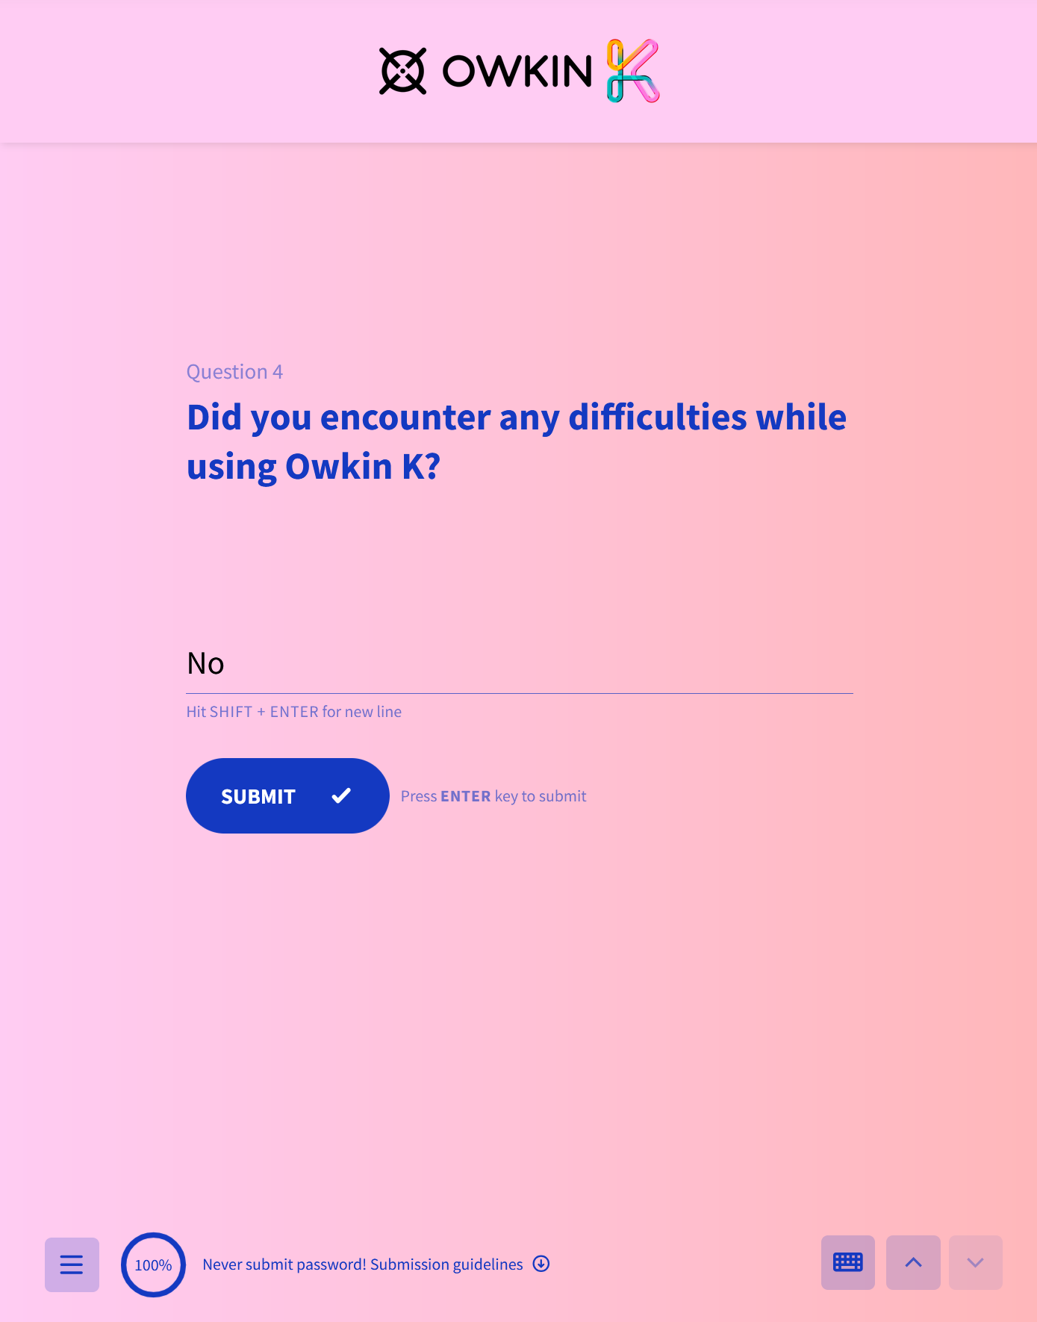
NPS Tool Implementation Progress
Customer success: Weekly Support Report – 04.03.2025
Where we are now ?
✅ SurveySparrow NPS Widget Development & Integration
Successfully applied Owkin K brand colors to ensure a seamless user experience.
Prepared JavaScript widget code for frontend developers.
Scheduled meeting today at 12 PM with an Owkin K developer to discuss integration and next steps.
Potential Conflict with Existing NPS Tool
It appears that another NPS tool is already being implemented for Owkin K.
Today’s 12 PM meeting will clarify which tool is being integrated and whether there is an overlap with SurveySparrow.

Slide 5
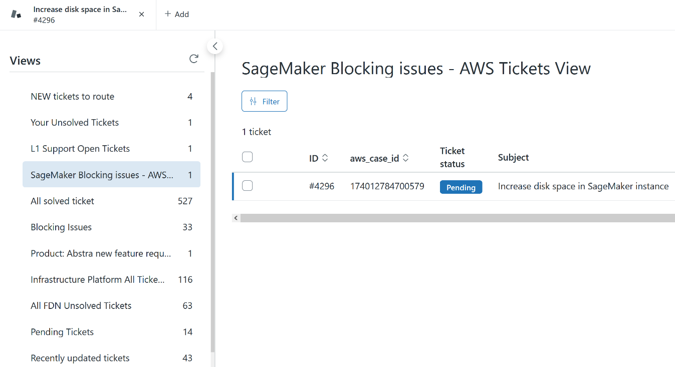
Challenges & Solutions
Customer success: Weekly Support Report – 04.03.2025
Some of them:
🔹 Challenge: Uncertainty Around SageMaker Blocking Issues & AWS Escalation
✅ Solution:
Users can select "Blocking Issue" when creating a ticket, but we are not always sure whether it should go to AWS or be handled internally.
Currently monitoring each SageMaker blocking issue, immediately reviewing it with the Research team to confirm whether escalation to AWS is necessary.
🔹 Challenge: NPS Tool Overlap
✅ Solution:
Investigating the alternate NPS tool that is being integrated into Owkin K.
Meeting with an Owkin K developer today at 12 PM to understand the implementation details and determine how it compares with SurveySparrow.

Slide 6
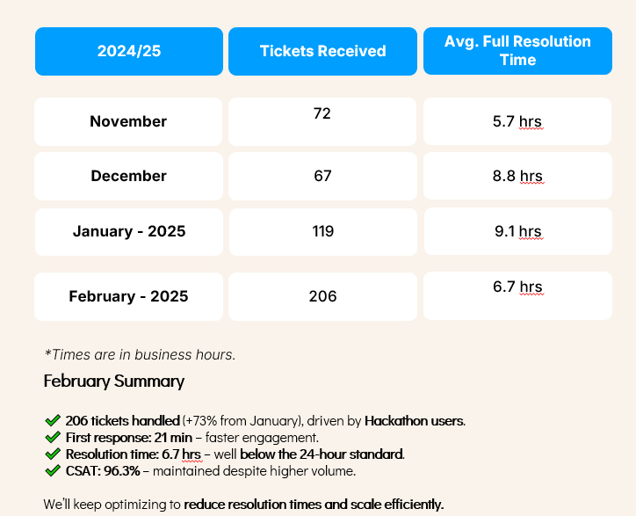
Key Metrics & Performance Highlights
Customer success: Weekly Support Report – 04.03.2025
What was done:
📊 Performance Overview for the Week:
First response time: 21 minutes (Maintained at an optimal level)
Total tickets handled: 214
SageMaker blocking issues resolved: 12 cases via Zendesk AWS integration (~1 hour avg per case)
CSAT score: 96.8% (Would have been 100% without the single negative rating from a non-issue ticket)
Zendesk forms updated: 2 new request forms + 220+ fields added
NPS Widget Development: Styled and prepared for integration discussion
🚀 Key Wins:
✅ 93.9% of tickets responded to within SLA
✅ Improved ticket auto-routing, reducing manual triage time by 15%
✅ First response time: 21 minutes

Slide 7

Next Steps & Focus Areas
Customer success: Weekly Support Report – 04.03.2025
What will be done:
📌 What’s Coming Next?
Validate the best NPS tool for Owkin K based on today’s meeting.
Continue tracking SageMaker blocking issues to ensure proper AWS escalation.
Further optimize Zendesk ticket routing for faster resolution.
Explore automation opportunities for common support workflows.
💡 Continuous Improvement:
Ensure sub-20 min first response time consistency.
Increase L2 ticket resolution involvement.
Strengthen internal processes for future growth.

Slide 8

Q&A
Customer success: Weekly Support Report – 25.02.2025
?

Slide 9
Thank you!

